Slide 1
Project 1A
CS111 Discussion 1D

Slide 2
Some Logistics
Your projects will be graded on lnxsrv09, test on that server
Once you posted your project on ccle, download it and make sure that everything is there
Any questions about the projects should be posted on campuswire
The lateness policy is:
10% off per day, capped at 3 days - after which your project will not be graded
Make sure to mention the slipdays that you use

Slide 3
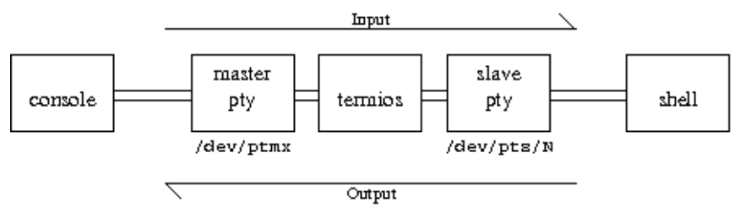
termios(3)
Manual Sections
Goal: act on streams between console and shell
Actions include: line buffering/editing, echo
Newline translation, signal generation
Notes:
Line buffering – when characters come in the left, it holds on to them until it receives a newline, at which point they are all emitted out the right at once.
Echo – when a character comes in the left, in addition to being buffered or sent out the right, it is also sent back out the left. This is why you can see what you’re typing.
Line editing – When the ERASE character (^?, ASCII 0x7f by default) comes in the left, assuming that there is anything in the input buffer, the last character in the input buffer is deleted, and the sequence "\b \b" is sent out the left. "\b" (ASCII 0x08) tells your terminal to move the cursor one column to the left, so this moves the cursor one column backwards, overwrites the last character with a blank space, and then moves the cursor back.
Newline translation – if a newline ("\n", ASCII 0x0A) comes in the right, a carriage-return/line-feed combination (CRLF, "\r\n", ASCII 0x0D 0x0A) is sent out the left. While most programs on UNIX accept a bare "\n" as a newline, your terminal needs both – "\r" tells it to move the cursor to the beginning of the line, and "\n" tells it to move to the next line.
Signal generation – if a INTR (^C, ASCII 0x3 by default) comes in the left, it is discarded and a SIGINT is sent to the program on the far right. Similarly, if a SUSP (^Z, ASCII 0x1A) comes in the left, it is discarded and a SIGTSTP is sent to the program on the far right. (SIGTSTP, by default, stops a process. It differs from SIGSTOP primarily in that it can be caught and handled by a program, whereas SIGSTOP’s effect is unconditional)

Slide 4
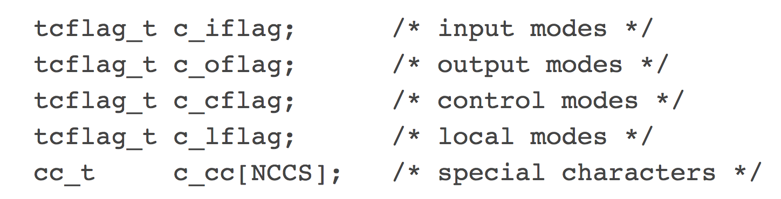
termios(3)
Manual Sections
Structure:
Each ‘flag’ field contains a number of flags that can be enabled/disabled
They are represented as bitmasks
c_lflag ‘flags’:
ICANON : enables line buffer/editing
ECHO : redirect input to output
ISIG : generate signals for ^C or ^Z

Slide 5
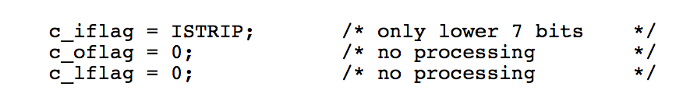
Non-canonical input mode / no echo
Terminal I/O
Get current terminal modes
Save them for restoration
Make a copy with these changes:
Restore saved terminal modes

Slide 6
Non-canonical input mode / no echo
Terminal I/O
Get current terminal modes
Save them for restoration
Make a copy with these changes:
Restore saved terminal modes

Slide 7
tcgetattr(3)
Manual Sections
Goal: Get the parameters associated with the terminal
Success: 0 // Error: -1
Open file descriptor associated with a terminal
Pointer to a termios structure

Slide 8
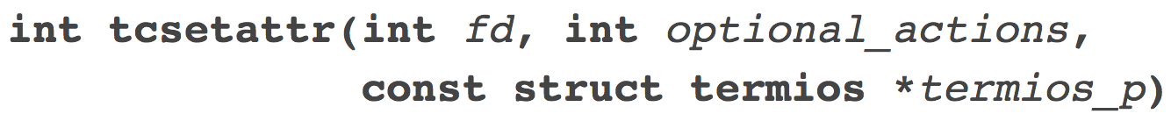
tcsetattr(3)
Manual Sections
Goal: Set parameters associated with the terminal
TCSANOW : make changes now
TCSADRAIN : make changes once output to fd transmitted
TCSAFLUSH : TCSADRAIN + all unread input discarded
Success: 0 // Error: -1
Open file descriptor associated with a terminal
Pointer to a termios structure

Slide 9
Workflow
Terminal I/O
tcgetattr(0, save)

Slide 10
Workflow
Terminal I/O
tcgetattr(0, save)
Make a copy
Modify flags
tcsetattr(0, TCSANOW, mod_copy)
Be able to restore:
tcsetattr(0, ... , save)

Slide 11
stty(1)
Manual Sections
Goal: change and print terminal line settings
You can modify pretty much anything
Remove echo -> stty -echo
Change ‘backspace’ character -> stty erase z
If things get weird : stty sane (built-in combo of stty options)
Notes:
stty -echo
Stty echo
Stty erase ^H
Stty erase ‘^?’

Slide 12
--shell
Inter-process communication
Execute a new shell :
Whose standard input is a pipe from the terminal
Whose standard outputs/error are pipes to the terminal
Read input from the keyboard :
Echo it to stdout
Forward it to the new shell
There will not be a strict alternation between input form the keyboard and output from the shell!

Slide 13

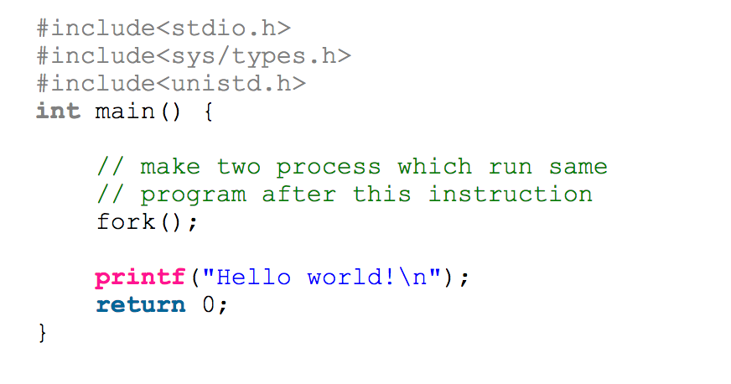
fork(2)
Manual Sections
Goal: Create a child process
Success:
Parent receives child PID
Child receives 0
Error: Parent receives -1
What is the output ?
Hello world
Hello world
2 processes running concurrently

Slide 14
fork(2)

Slide 15
fork(2)

Slide 16
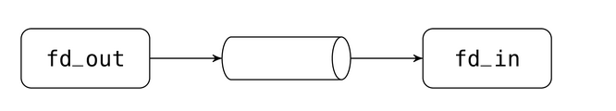
Pipe(2)
Manual Sections

Slide 17
Pipe(2)

Slide 18
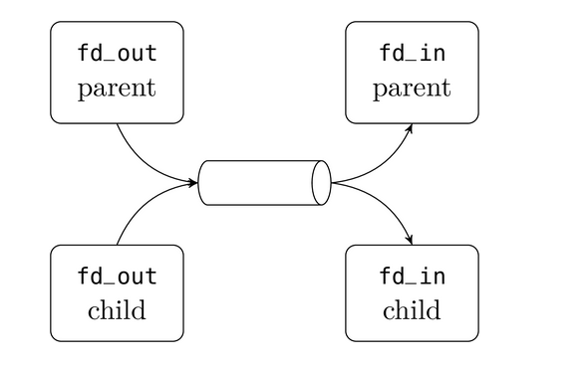
Pipe(2) : child is the writer
Manual Sections

Slide 19
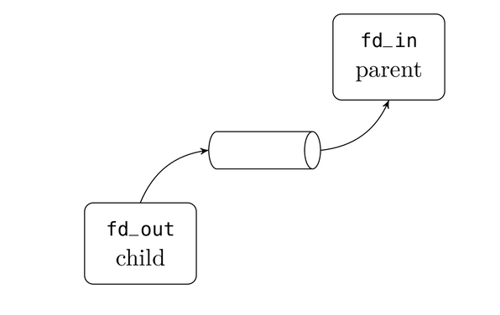
Pipe(2) : child is the writer
Manual Sections

Slide 20
exec(3)
Manual Sections
Goal: loading a new program in a calling process
Error : -1
Path to new process image file
Pointers to arguments available to new process image
List is terminated by a NULL pointer
For project 1A
the path is : “/bin/bash”
arguments are : “sh”, (char *) NULL
Notes:
Process image : program code / program data / stack / process control block

Slide 21
Which fd’s to close?
Pipes to shell
Do we pipe() after or before the fork()?
before , so that :
When using fork(), the child will receive all fds
That includes the ones created by pipe() calls
Both parent and child have access to both ends of the pipes()
Which do we need?
Parent side :
Input -> shell (we can close output to shell pipets[1])
shell -> output (we can close input from shell pipefs[0])
Child side :
Read from shell
Write to shell

Slide 22
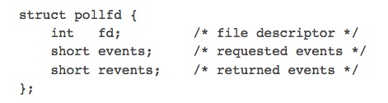
poll(2)
Manual Sections
Goal: Wait for some event on a file descriptor (for I/O)
Success: # of fd with monitored events // Error: -1
# of items in *fds
Maximum time that poll() blocks (ms)
Notes:
The field events is an input parameter, a bit mask specifying the events the application is interested in for the file descriptor fd. If this field is specified as zero, then all events are ignored for fd and revents returns zero.
The field revents is an output parameter, filled by the kernel with the events that actually occurred. The bits returned in revents can include any of those specified in events, or one of the values POLLERR, POLLHUP, or POLLNVAL. (These three bits are meaningless in the events field, and will be set in the revents field whenever the corresponding condition is true.)
The caller should specify the number of items in the fds array in nfds.
The field fd contains a file descriptor for an open file. If this field is negative, then the corresponding events field is ignored and the revents field returns zero. (This provides an easy way of ignoring a file descriptor for a single poll() call: simply negate the fd field.)
The bits that may be set/returned in events and revents are defined in <poll.h>:
Specifying a timeout of zero causes poll() to return immediately, even if no file descriptors are ready.
The timeout argument specifies the minimum number of milliseconds that poll() will block.
If none of the events requested (and no error) has occurred for any of the file descriptors, then poll() blocks until one of the events occurs.
WHAT IS INT RETURNED ()
HOW IS ERRNO SET?
WHY NOT USE READ ? ALLOW TIMEOUT

Slide 23
poll(2)
Manual Sections
Some of the bits that may be set/returned :
POLLIN : Data may be read without blocking
POLLOUT : Data may be written without blocking
POLLERR : (revents only) Error has occurred on device / stream
POLLHUP : (revents only) Device disconnected / pipe closed <- Mutually exclusive with POLLOUT
POLLNVAL : (revents only) Invalid fd
Notes:
Poll differs from select only in terms of how we specify which descriptors to track. With select, we pass in three sets of descriptors we want to monitor for reads, writes and exceptional cases. With poll we pass in a set of descriptors each marked with the events it specifically needs to track.

Slide 24
poll(2)
Manual Sections
Until EOF
Until interrupt
Example exercise: Poll on two descriptors for Normal data, or High priority data. If any found call function handle() with appropriate descriptor and priority. Don't timeout, only give up if error, or one of the descriptors hangs up.
Notes:
If ndfs is 0, millisecond sleep
If timeout negative, infinite time

Slide 25
poll(2)

Slide 26
kill(2)
Manual Sections
Goal: send a signal to a process (or a group)
(pid>0)? Send to process pid
(pid==0)? Send to all processes in group of sender
(pid==-1)? Send to all processes in group of calling process
(pid<-1)? Send to all processes whose gpid = abs(pid)
What signal will you send ? SIGINT for 0x03
Success: 0 // Error: -1
Receiving process id
Signal to be sent
Notes:
The kill() system call can be used to send any signal to any process group or process.
If pid is positive, then signal sig is sent to the process with the ID specified by pid.
If pid equals 0, then sig is sent to every process in the process group of the calling process.
If pid equals -1, then sig is sent to every process for which the calling process has permission to send signals, except for process 1 (init), but see below.
If pid is less than -1, then sig is sent to every process in the process group whose ID is -pid.
If sig is 0, then no signal is sent, but error checking is still performed; this can be used to check for the existence of a process ID or process group ID.
For a process to have permission to send a signal it must either be privileged (under Linux: have the CAP_KILL capability), or the real or effective user ID of the sending process must equal the real or saved set-user-ID of the target process. In the case of SIGCONT it suffices when the sending and receiving processes belong to the same session.

Slide 27
waitpid(2)
Manual Sections
Goal: wait for child process to change state
pid of terminated child / Error: -1
Location to store exit information
<-1 : wait for any child process whose gpid == abs(pid)
-1 : wait for any child process
0 : wait for any child process whose gpid == (calling process pid)
>0 : Wait for the child whose pid == pid
OR of these parameters:
WNOHANG : return immediately if no child exited
WUNTRACED : also return if a child has stopped. Status for children which have stopped is provided
WCONTINUED : also return if a stopped child has been resumed by SIGCONT

Slide 28
waitpid(2)
Manual Sections
When will you use it ?
=>Wait for the shell to exit

Slide 29
Overall Workflow
Define options
Get terminal parameters
Replace terminal parameters but store copy of parameters in memory for exit conditions
Setup the pipes between input and shell, fork the program
Exec the shell in child, differentiating on the basis of pid for parameters passed and pipe entrances/exits closed
Setup a polling function to wait for inputs before processing to prevent blocking
Setup functions for processing input read from pipes and written to them
Setup functions for exit handling strategies (final exit utilizes waitpid() for shell output to stop)
For good code setup various output print logs for debugging when the option is selected

Slide 30
FAQ
confirming interrupt generation to shell FAIL ...
shell did not report receiving SIGINT
What happened?
Modify line 369 of the test script to : SEND ‘^C\r’

Slide 31
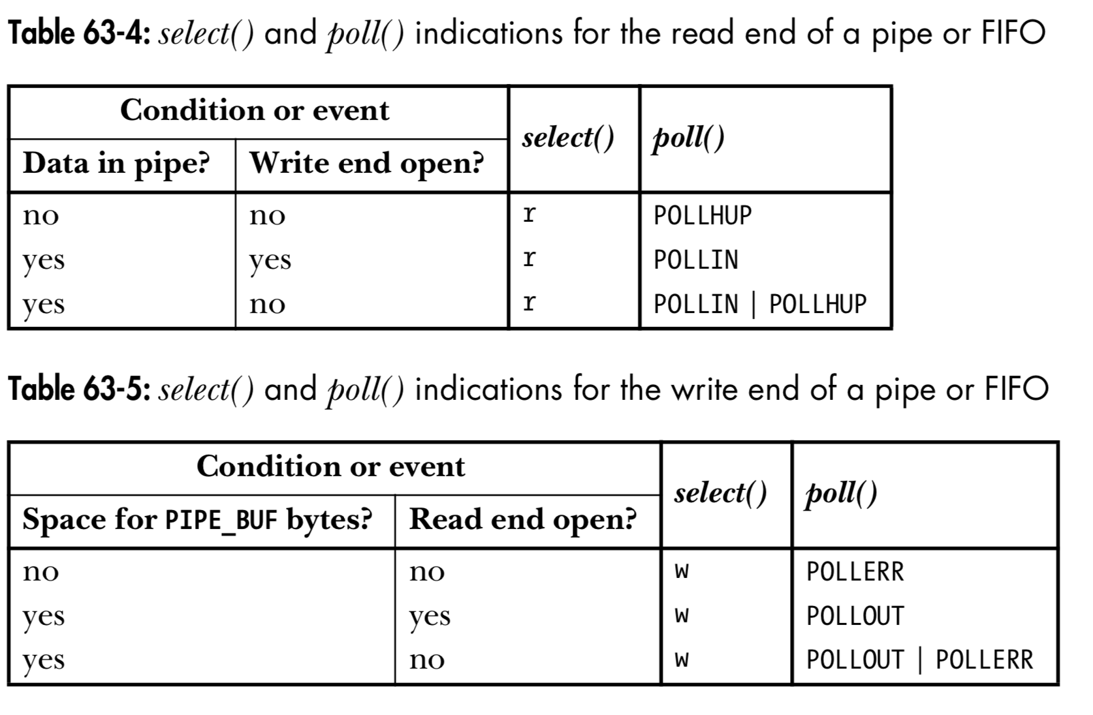
FAQ
Should POLLHUP and POLLERR be treated differently?
Cf The Linux Programming Interface (Kerrisk, 2010)
Chapter 63, page 1343

